Slide 1

Capstone Project: Job Salary Prediction
Using Machine Learning and Deep Learning to predict job salary for data professionals
Bonnie Ma
June 2020

Slide 2

Executive Summary
This project aims to provide data science/data analytics professionals a clear view on what common skills they need to succeed in job search and what salary they can expect from a position

Slide 3

Agenda
Project Roadmap
The Job Market for Data Professionals
Modeling Approach and Deployment

Slide 4
Project Roadmap (CRISP-DM)
10,000 + postings were scrapped from Indeed.com
Define the scope based on business understanding
Web scrapping
Initial data processing and exploratory analysis
Text cleaning and processing
Build machine learning and deep learning models
Model tuning and evaluation
Deploy
A web application
The best model was selected based on test accuracy
7 models were built using different learning techniques
Capstone Project

Slide 5
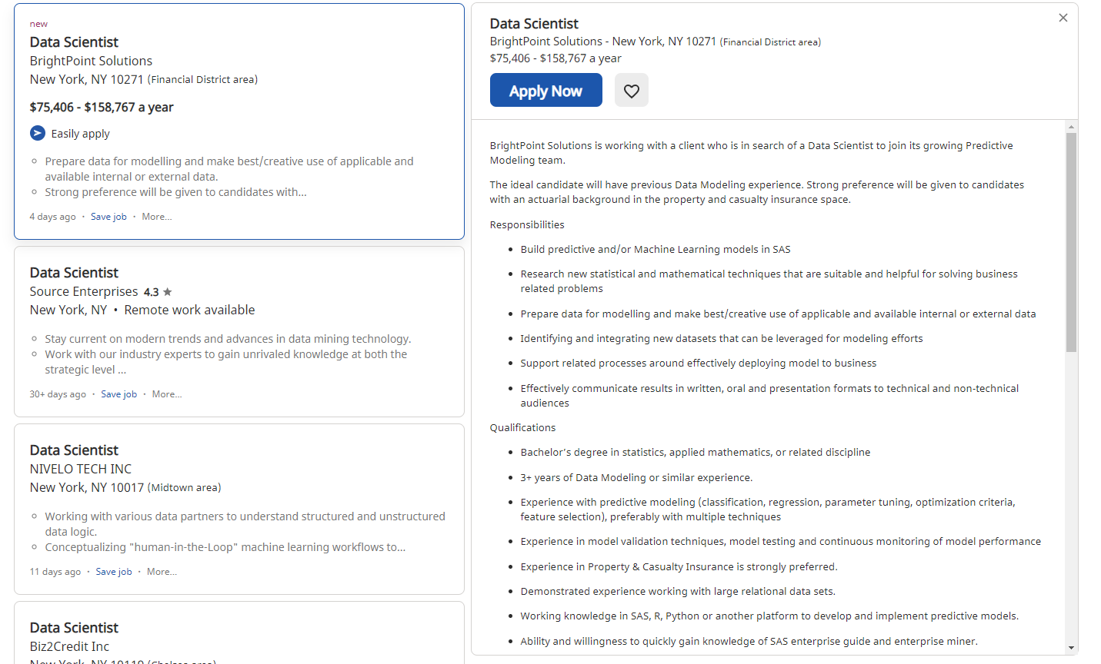
Understand the data
Main dataset:
Web scrapping 10,000+ data postings from Indeed.com
Main features are extracted from job title + job description for text classification models
Target variable is adjusted average yearly salary
Other dataset:
Cost of Living Index, Purchasing Power Index by City
position
company
Job description
location
salary
Capstone Project

Slide 6

The Job Market for Data Professionals

Slide 7
Common Words in one JD
Common Titles

Slide 8
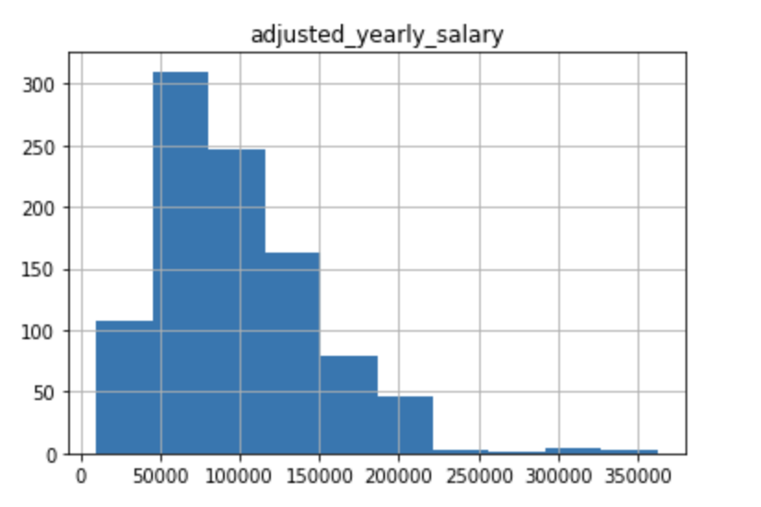
Salary Distribution
Majority of the Full Time data related jobs have a adjusted yearly salary of 50K ~ 200K across different seniority levels and industries. We transformed them into 6 bins for better prediction.
Capstone Project

Slide 9
Common Titles in Each Salary Bin
We tokenized job titles and create uni-gram and bi-grams to reflect 20 most common words appeared in each salary range
Sales, marketing appear more frequently in lower tier
While data, engineer, business analyst, data scientist appear more frequently in middle tier
Director, manager, along with business, data, analytics appear more frequently in higher tier
It seems data engineers/ data scientists can have a relatively high starting salary, however, needs managerial experiences to grow salary to the next level
Capstone Project

Slide 10
Cost of Living vs Median Salary
Higher average salary does not necessarily mean better quality life.
New York has the highest Cost of Living while just above average salary
San Jose and Raleigh-Durham have the lowest Cost of Living/Salary ratio

Slide 11

The Modeling Approach

Slide 12
We built 7 Models with different Word Vectorization and Classification Methods
 | Test Accuracy
Model 1: Count Vectorizer + TF-IDF Transformation + SGD Classification | 0.71
Model 2: Word2Vec Embedding + Random Forest Classification | 0.51
Model 3: Pre-trained GloVe Embedding + Classification Models (Random Forest/SGD) | 0.37
Model 4: Word Embedding Layer + Simple Neural Network Model | 0.515
Model 5: Pre-trained GloVe Embedding + Deep Neural Network Model | 0.526
Model 6: Mixed Input Network Model with City, Rate Type, and Cost of Living Indexes | 0.518
Model 7: Job Title, City, Cost of Living Indexes + Classification Models | 0.38
Notes:
train-test split 0.1

Slide 13
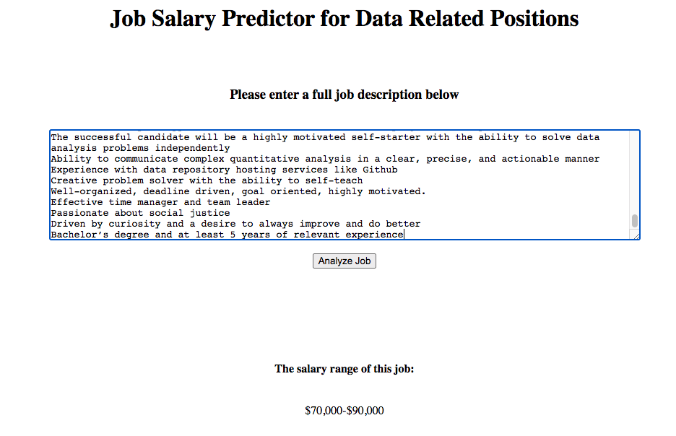
Model Deployment
https://data-job-salary-predictor.herokuapp.com/

Slide 14




Thank You
Bonnie Ma
majie13000@gmail.com
https://github.com/bonniema/salary-predictor

Slide 15
Mixed Input Neural Network Model
Numerical/Categorical Variables
Text Data (Tokenized)
Multi-layer Perceptron
(MLP)
Convolutional Neural Network
Concatenate
Dense Layer

Slide 16
Confusion Matrix for Model 1
Notes:
Model 1 predicts 0-50K most accurately, followed by 90k-120k, 50-70k and 120k-150k

